Slide 1
Assessment for Data Analyst Role (Tableau, Power BI)
Part 1: Theoretical Knowledge
Part 2: Practical Application
Part 3: Advanced Analytics
Part 4: Scenario-Based Questions

Slide 2
Part 1: Theoretical Knowledge
Understanding Data Visualization
Question: Explain the importance of data visualization in data analysis. What are the key principles of effective data visualization?
Data Visualization is a crucial part in data analysis because it transforms the complex data into graphical format. And as well making it easier to understand for users or customers. Visualization in making data-driven by providing a clear presentation of the data.
Key Principles:
Clarity | Accuracy | Simplicity
Relevance | Consistency | Accessibility

Slide 3
2. Tableau Basics
Question: What are the main components of Tableau? Describe the process of creating a basic
dashboard in Tableau.
The main Components of Tableau:
Tableau Desktop
Tableau Server
Tableau Online
Tableau Prep
Tableau Public
Process of creating a basic dashboard:
Step-1 : Connect to Data
Step-2 : Create Worksheets
Step-3 : Design Visualizations
Step-4 : Build the Dashboard
Step-5 : Add Interactivity
Step-6 : Finalize and Publish

Slide 4
3. Power BI Fundamentals
Question: Discuss the main features of Power BI. How does Power BI differ from Tableau in terms of functionality and use cases?
Main features:
Power Query
Power BI Desktop
DAX (Data Analysis Expressions)
Power BI Service
Power BI Mobile
Power BI Embedded
How does Power BI differ from Tableau in terms of functionality and use cases:
Power BI works really well with Microsoft products like Excel and Azure, which is great if you already use those tools. Tableau can connect to a wide variety of data sources, making it flexible for different kinds of setups.
Power BI offers pre-made charts and dashboards that are easy to use and set up. Tableau provides more advanced and customizable visualizations, allowing for detailed and interactive data presentations.

Slide 5
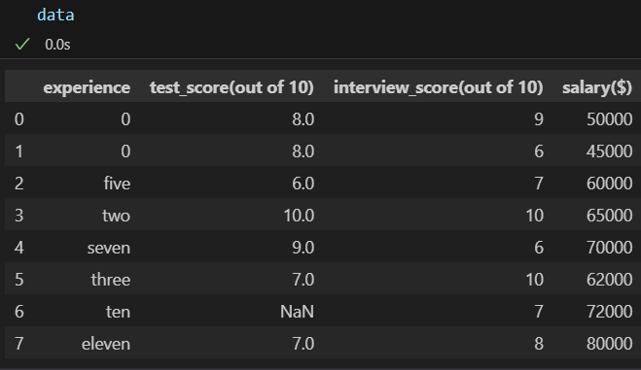
Part 2: Practical Application
4. Data Cleaning and Preparation
Problem Statement: Given a dataset with missing values and inconsistencies, clean and
prepare the data for analysis.
Dataset:

Slide 6
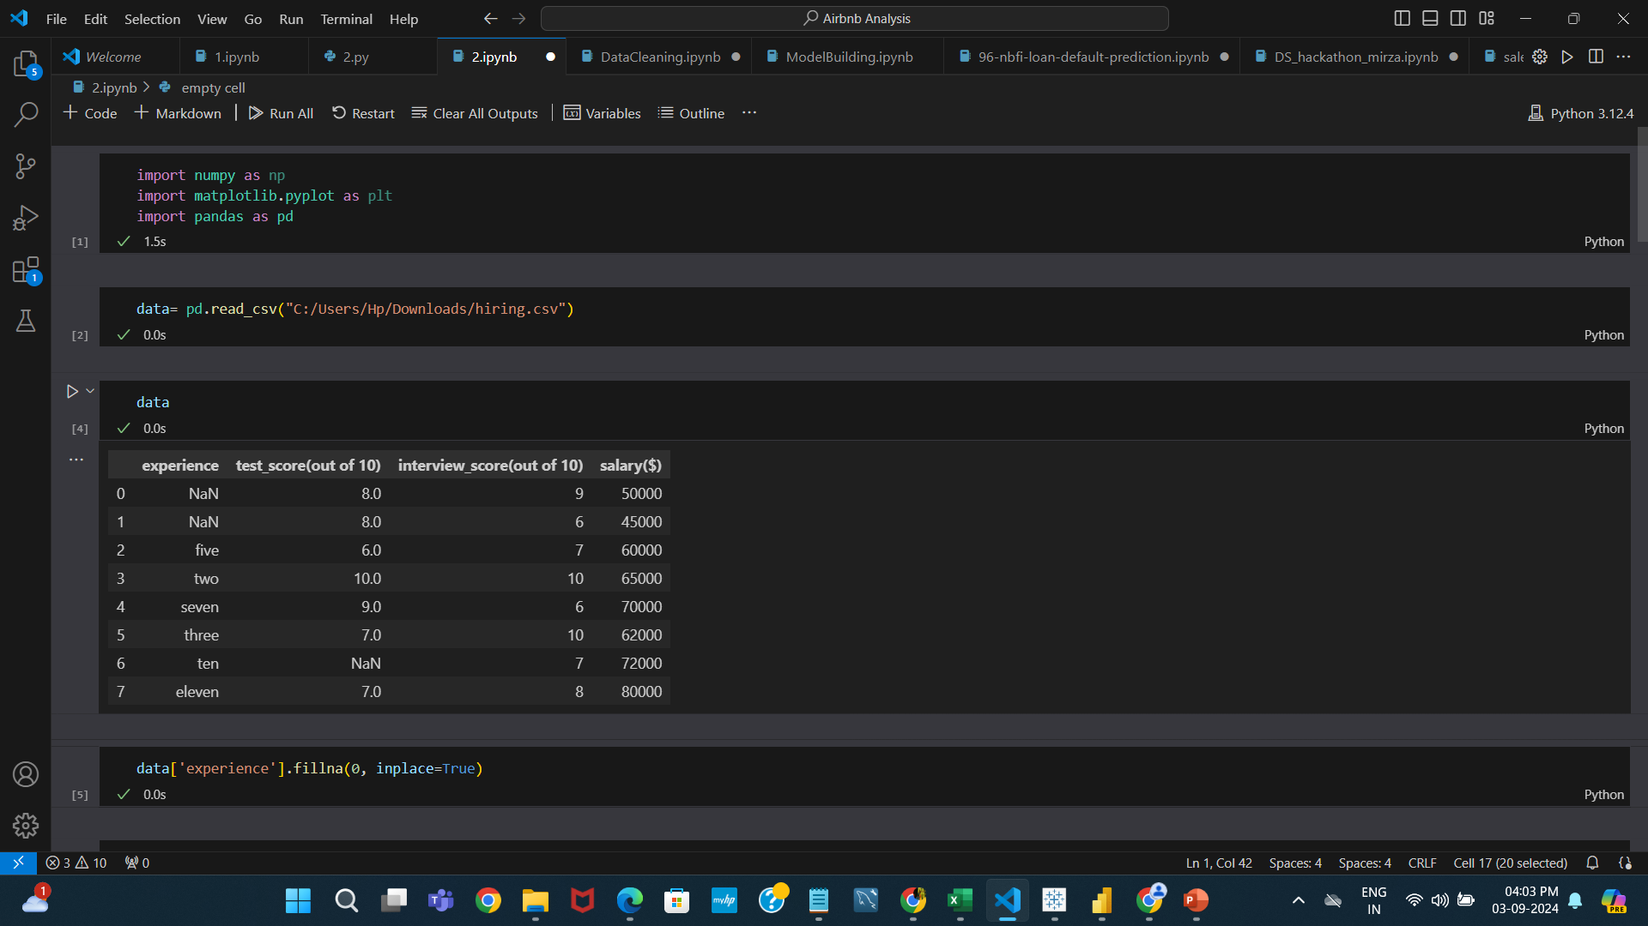
Here is the steps taken to handle missing values and inconsistencies.
In here, I loaded data and after that I use some techniques to handle missing values to become a cleaned data.

Slide 7
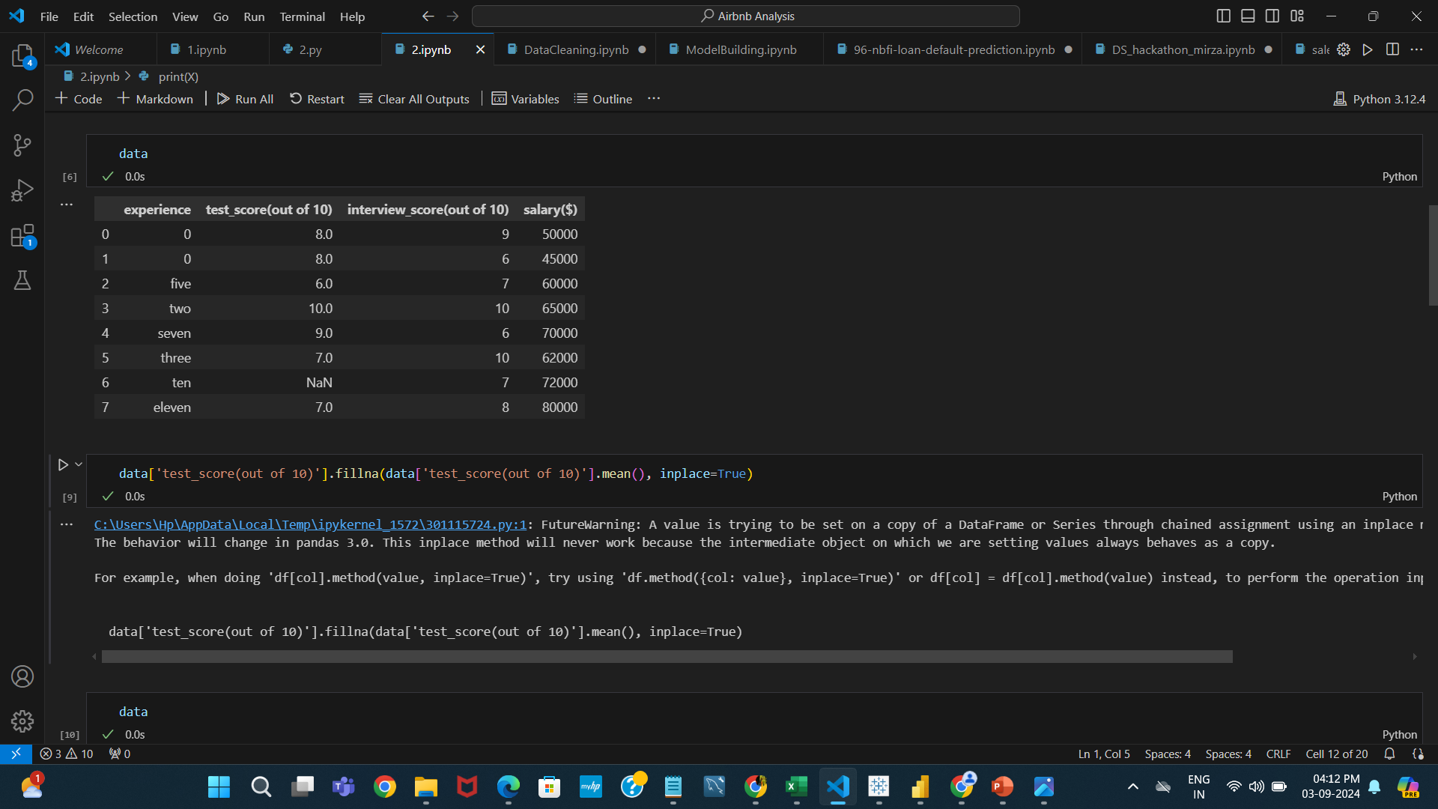

Slide 8
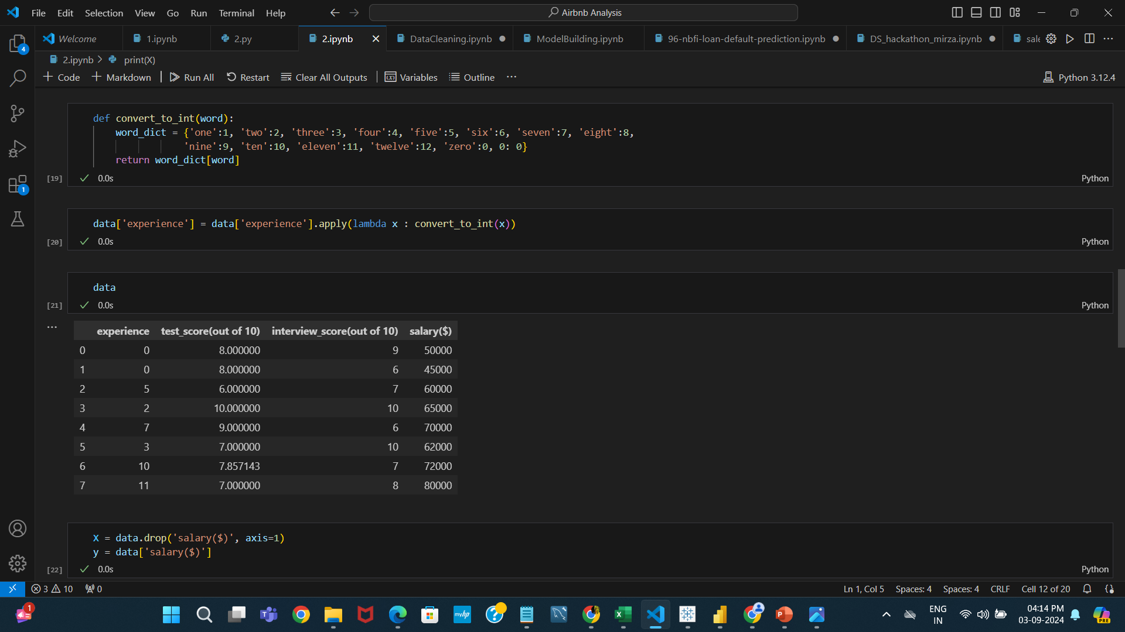

Slide 9
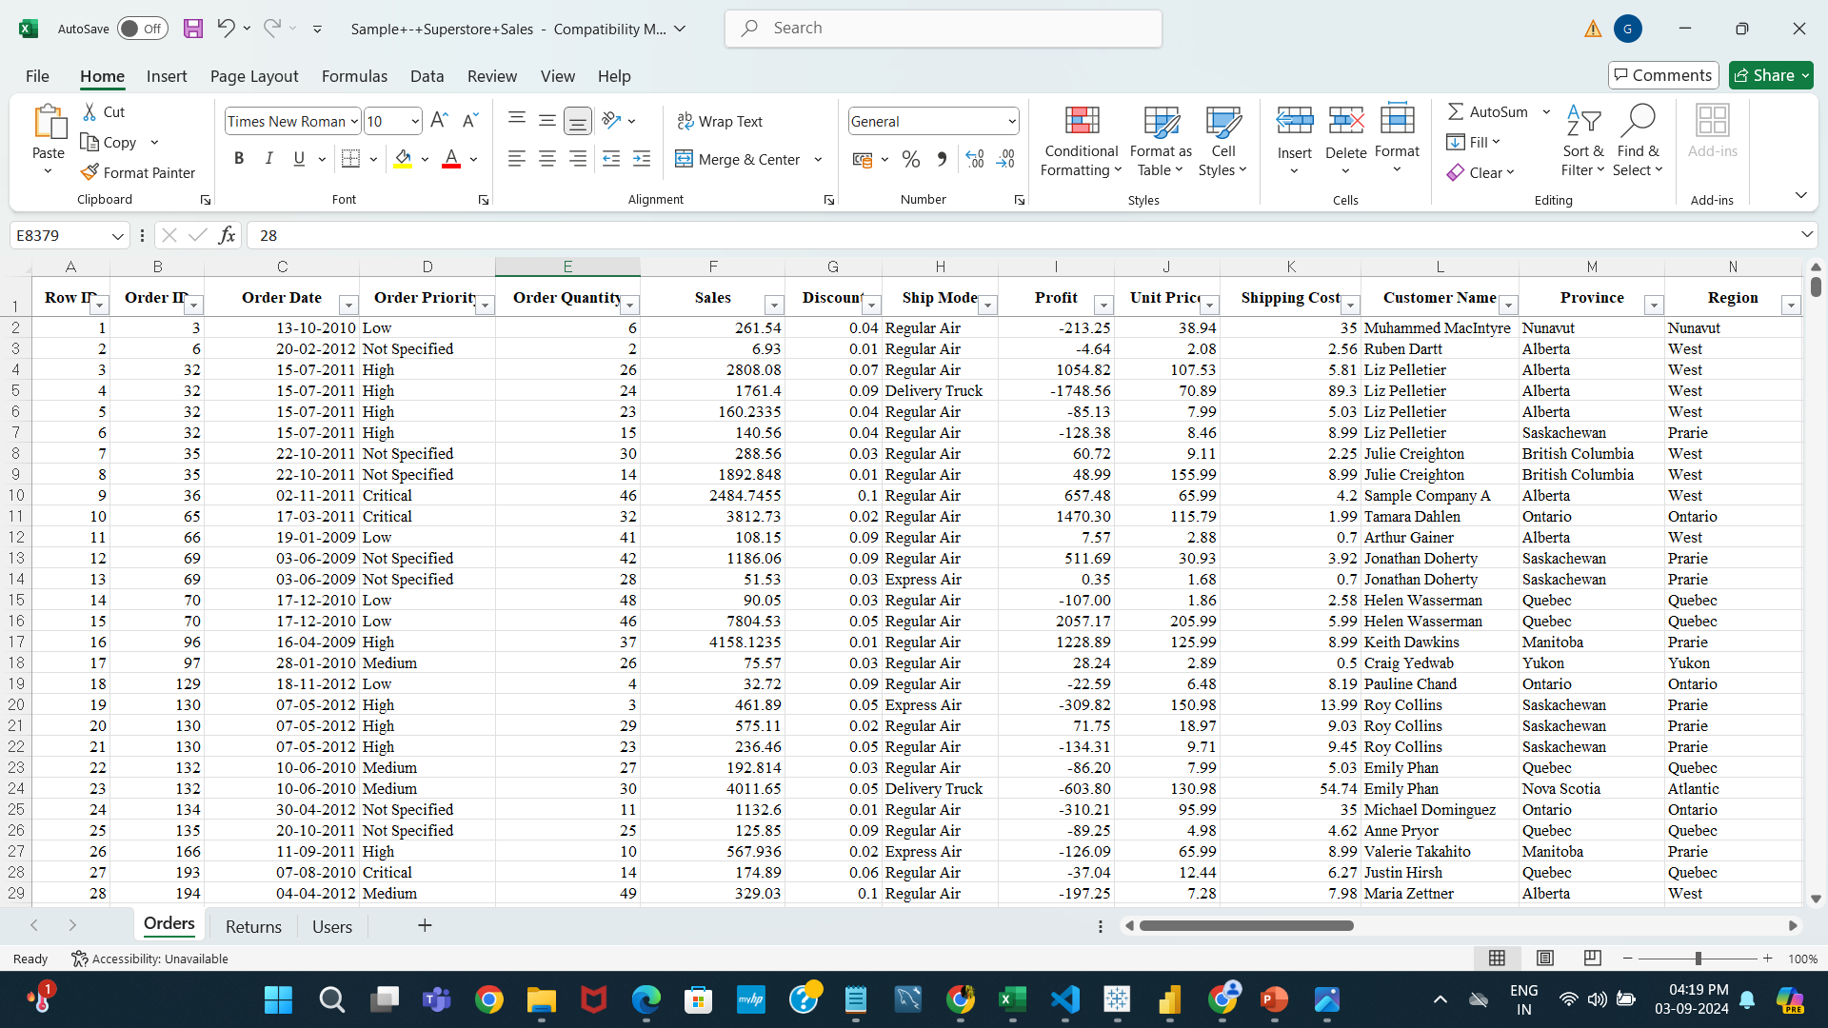
5. Tableau Visualization
Problem Statement: Create an interactive sales dashboard in Tableau using the provided sales
dataset. The dashboard should include key metrics such as total sales, sales by region, and
sales trends over time.
I use this Excel dataset(Super Store Sale Data) for creating a dashboard for this question.

Slide 10
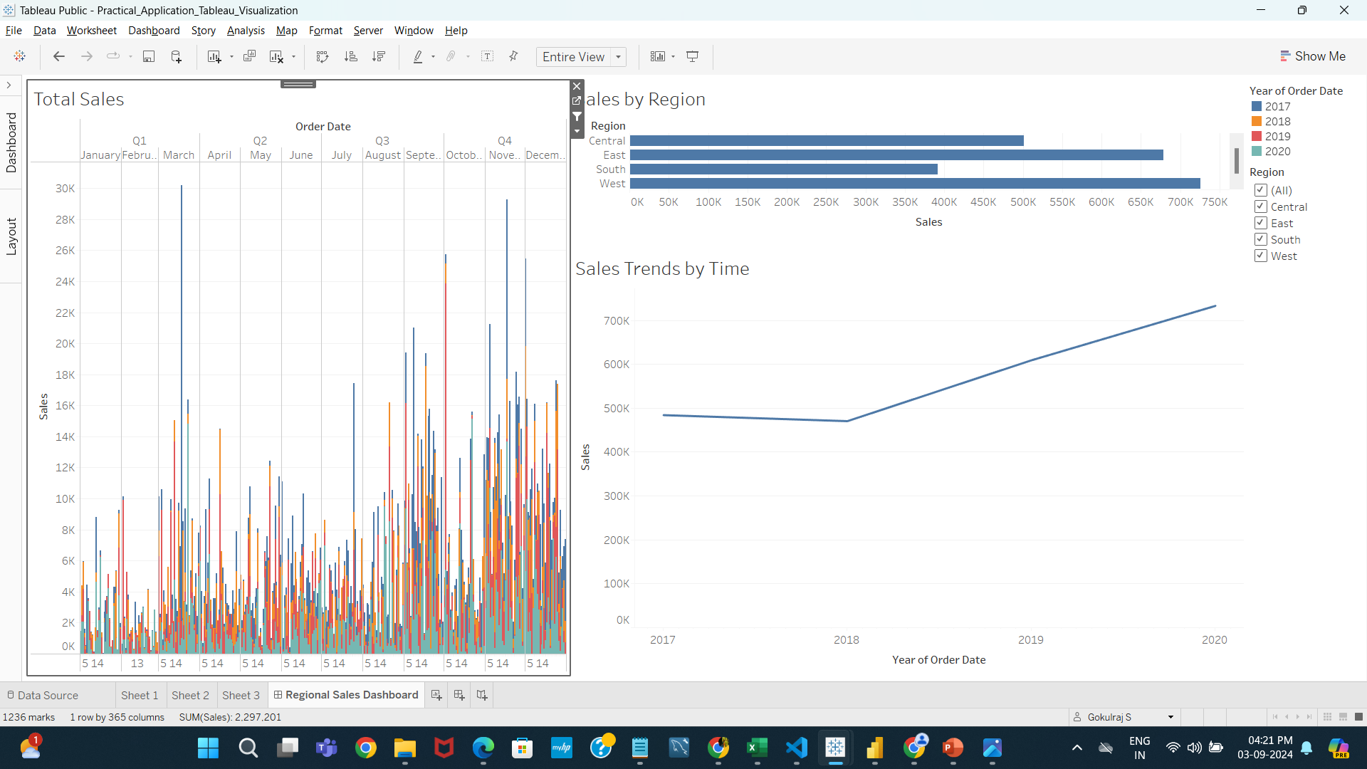
Tableau Visualization
Practical_Application_Tableau_Visualization | Tableau Public

Slide 11
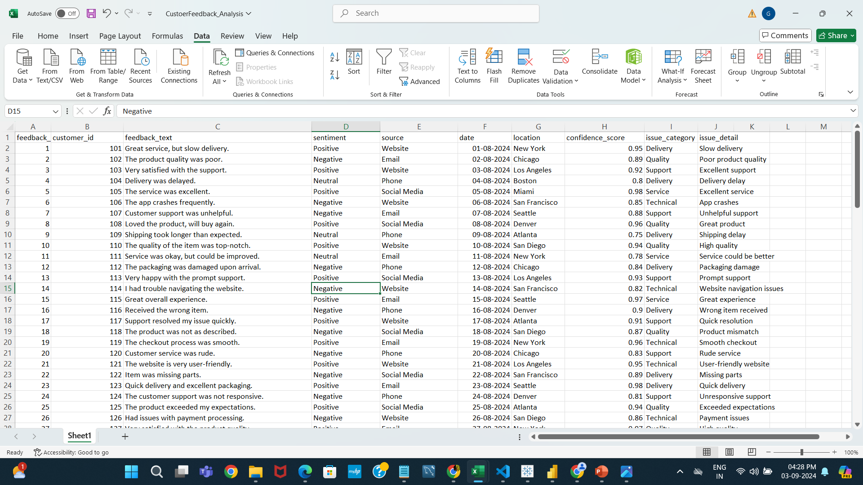
6. Power BI Report
Problem Statement: Develop a report in Power BI to analyze customer feedback data. The
report should highlight customer satisfaction levels, common issues, and trends over time.
I use this Excel dataset(Customer Feedback Data) for creating a dashboard for this question.

Slide 12
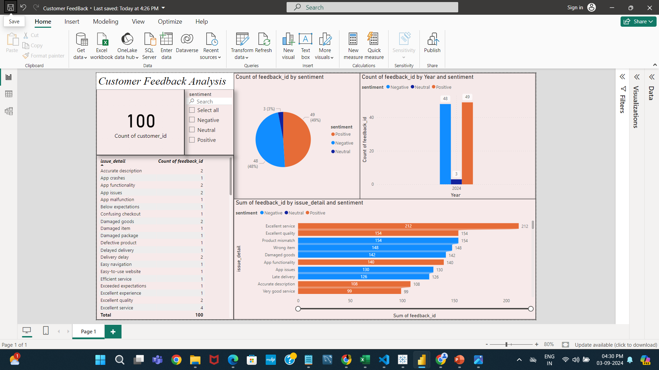
Customer Feedback Dashboard:
https://drive.google.com/file/d/1wYN-mXszkgKDJkuJz8KuIZakmxaqJQ1l/view?usp=sharing

Slide 13
Part 3: Advanced Analytics
7. Statistical Analysis
Problem Statement: Perform a statistical analysis on a given dataset to identify significant
trends and correlations. Provide a summary of your findings.
Dataset This dataset(Laptop Price Analysis) was used for this question.
This_is_the_code_link_for_Laptop_Price_Analysis In here I used to analyses all the steps by cleaning to correlation for all things.

Slide 14
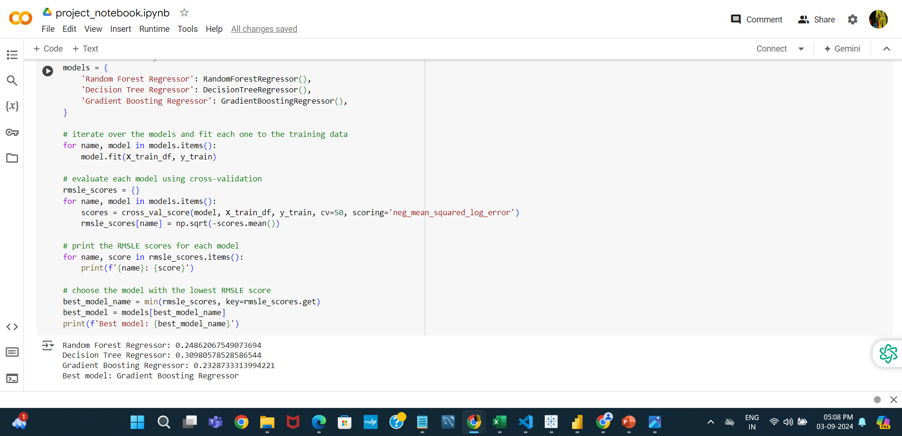
8. Predictive Analytics
Problem Statement: Build a predictive model to forecast sales for the next quarter using
historical sales data. Explain the steps taken and the rationale behind your model choice.
Project ← This is the project link

Slide 15
Part 4: Scenario-Based Questions
9. Real-World Problem Solving
Question: Imagine you are given a large dataset with customer transactions. How would you
approach the task of identifying key customer segments and their behaviors? Describe the
steps and tools you would use.
Data Preparation:
Clean the Data: Handle missing values, remove duplicates, and correct any inconsistencies.
Feature Engineering: Create relevant features, such as total spending, frequency of purchases, and recency of transactions.
Exploratory Data Analysis (EDA):
Analyze Basic Statistics: Understand distributions, ranges, and basic statistics of different features.
Visualize Data: Use histograms, scatter plots, and heatmaps to identify patterns and relationships.
Segmentation Techniques:
K-Means Clustering: Apply K-Means clustering to segment customers based on features like spending, frequency, and recency.
Actionable Insights:
Report Findings: Summarize the segments and their behaviors in a report.
Recommendations: Provide actionable recommendations based on segment profiles.

Slide 16
10. Data-Driven Decision Making
Question: A company wants to launch a new product and has collected survey data on
customer preferences. How would you use this data to help the company make an informed
decision? Outline your approach.
Data Preparation:
Clean the Data: Address any missing values, outliers, and inconsistencies.
Normalize Data: Ensure data is in a comparable format, especially if combining multiple survey questions.
Exploratory Data Analysis (EDA):
Analyze Descriptive Statistics: Summarize responses with mean, median, mode, and standard deviation.
Visualize Preferences: Use bar charts, pie charts, and histograms to understand distribution and trends in preferences.
Segmentation Analysis:
Identify Key Segments: Segment responses based on demographics or preference patterns.
Cross-tabulate: Analyze relationships between different survey questions to uncover insights.
Hypothesis Testing:
Conduct Statistical Tests: Perform tests like Chi-square tests or T-tests to validate significant differences in preferences among segments.

